Slide 1
AI Coursework 2
23050386
NP01CP4A230194
C8
Prashanna Sthapit

Slide 2
Topic
Predicting Emergency Readmission of Discharged Heart Failure Patients: A Comparative Analysis of XGBoost, Random Forest, and Logistic Regression

Slide 3
Explanation of the AI concepts used
Logistic Regression: It is a statistical classification model commonly used in medical research for binary outcomes, provides interpretability and insight into feature importance.
Random Forest: It is a ensemble machine learning method. It combines many decision trees to improve the prediction accuracy and reduce overfitting.
XGBoost: It is a powerful gradient boosting algorithm, builds trees sequentially to optimize predictive performance and handle complex nonlinear relationships.

Slide 4
Research evidences
(Bobak J. Mortazavi, 2016) compared machine learning algorithms for predicting readmission of heart failure patients and found that Random Forest outperformed logistic regression by capturing complex interactions between patient vitals and lab results.
(Sara Bersche Golas M, 2018) used XGBoost algorithm to predict 30 day readmissions in heart failure patients, achieving a higher area under the curve (AUC) compared to traditional clinical risk scores, demonstrating the value of gradient boosting in handling missing medical data.
(Fuhai Li, 2021) developed and validated an XGBoost based prediction model for in hospital deaths among ICU admitted patients suffering from heart failure using the MIMIC-III database, showing superior discrimination and calibration compared with the GWTG-HF risk score and demonstrating the effectiveness of machine learning for risk in critically ill heart failure patients.
(Samir E AbdelRahman, 2014) analyzed electronic health records for HF patients and concluded that feature selection is critical. Variables like Brain Natriuretic Peptide (BNP) and creatinine levels were identified as top predictors by Random Forest algorithms.
(Cida Luo, 2022) demonstrated that ensemble techniques like XGBoost could effectively handle class imbalance, a common issue where the number of readmitted patients is significantly smaller than those not readmitted.

Slide 5
Reason for selection of the topic
Heart failure has high emergency readmission rates, creating risk for patients and pressure on healthcare systems.
Early identification of high-risk patients can improve discharge planning and follow-up care.
Machine learning provides an opportunity to analyse complex clinical data more effectively than traditional rule-based methods.
The topic aligns with real-world healthcare challenges and demonstrates practical use of AI in medical decision support.

Slide 6
Solution
A supervised machine learning–based prediction system was developed.
Three models were implemented and compared:
  Logistic Regression
  Random Forest
  XGBoost
The goal was to identify patients likely to return to the emergency department within six months of discharge.
Model comparison was used to select the most reliable and clinically suitable approach.

Slide 7
Explanation of the solution and developed application (how it works)
Clinical data is collected from heart failure patient records.
Data preprocessing includes encoding categorical variables and scaling numerical features.
The dataset is split into training and testing sets.
Models are trained using historical outcomes (readmitted or not).
Each model predicts the probability of emergency readmission.
Performance is evaluated using recall, accuracy, F1-score, and ROC-AUC.
The best-performing model is selected for decision support.

Slide 8
Achieved results
Logistic Regression achieved the best overall performance on this dataset.
It showed strong recall and ROC-AUC, which are critical for medical risk prediction.
Random Forest performed competitively but did not consistently outperform Logistic Regression.
XGBoost did not perform as expected, likely due to dataset size and feature characteristics.
Results show that simpler models can outperform complex models in structured clinical data.

Slide 9
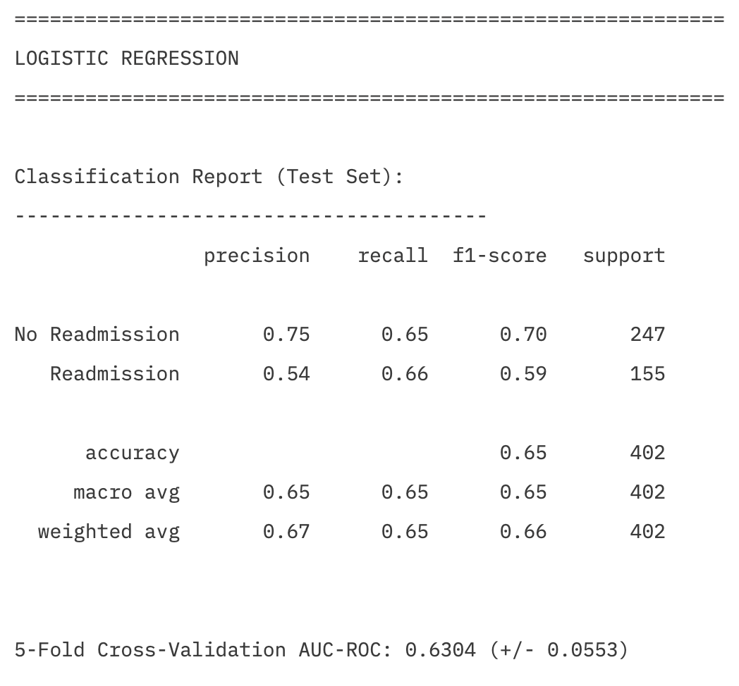
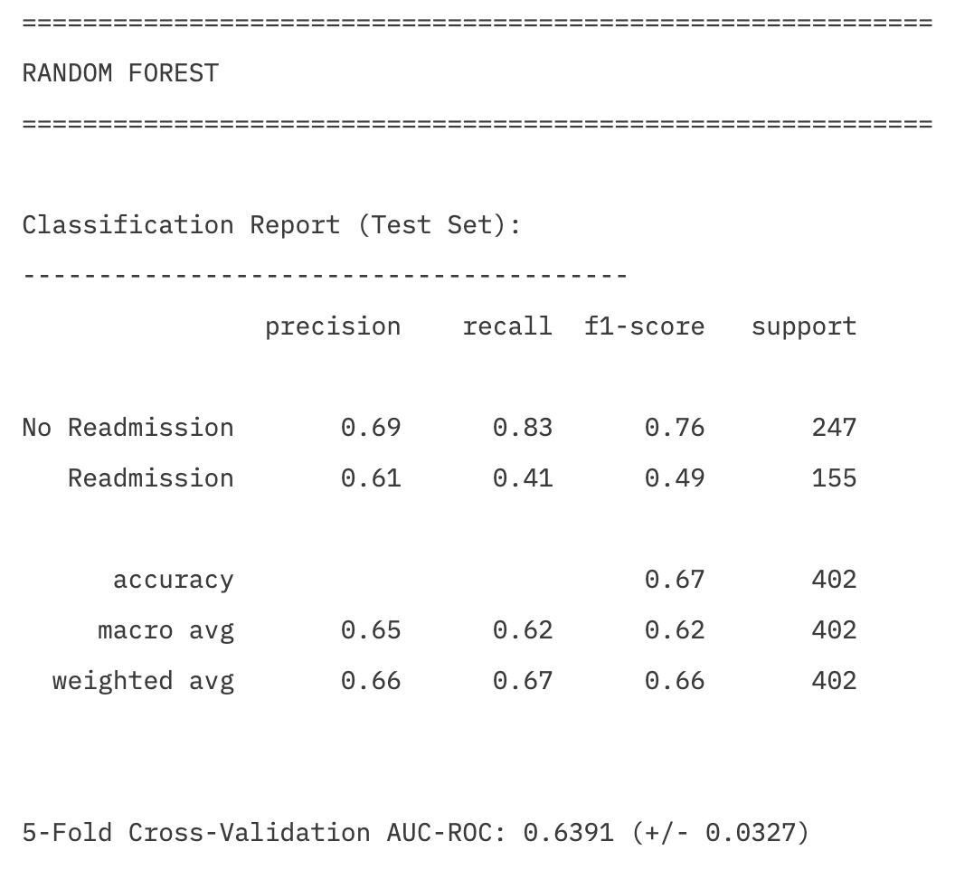
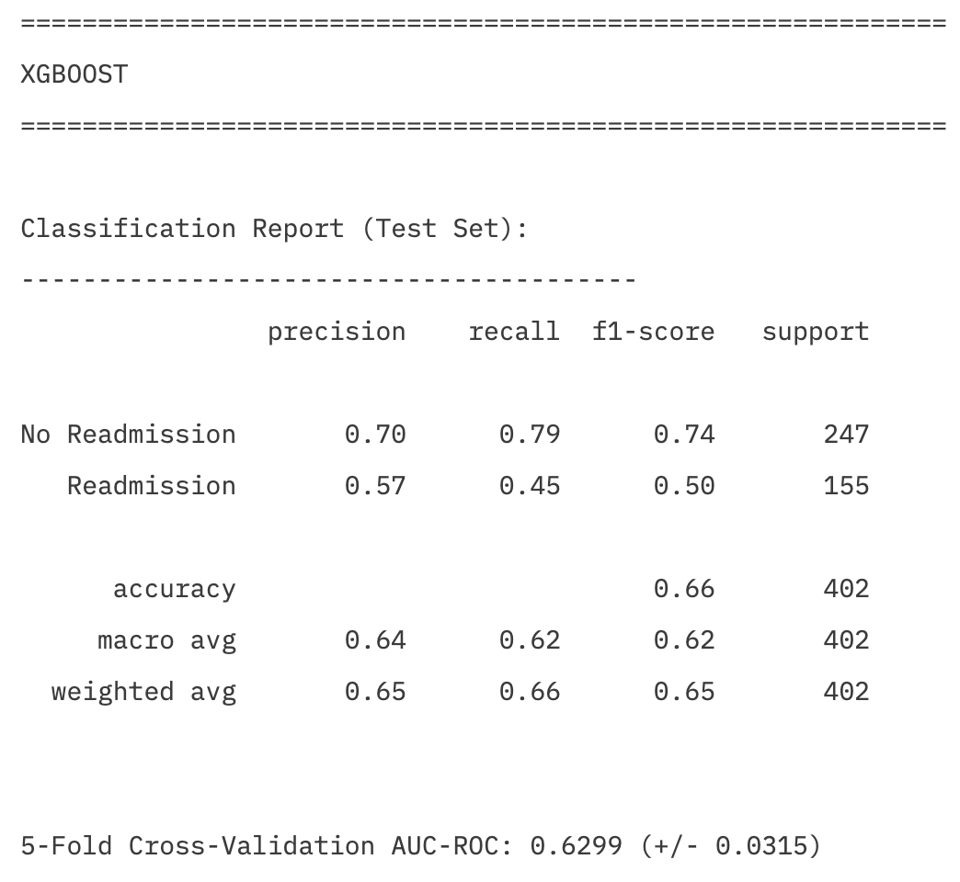
Achieved results

Slide 10
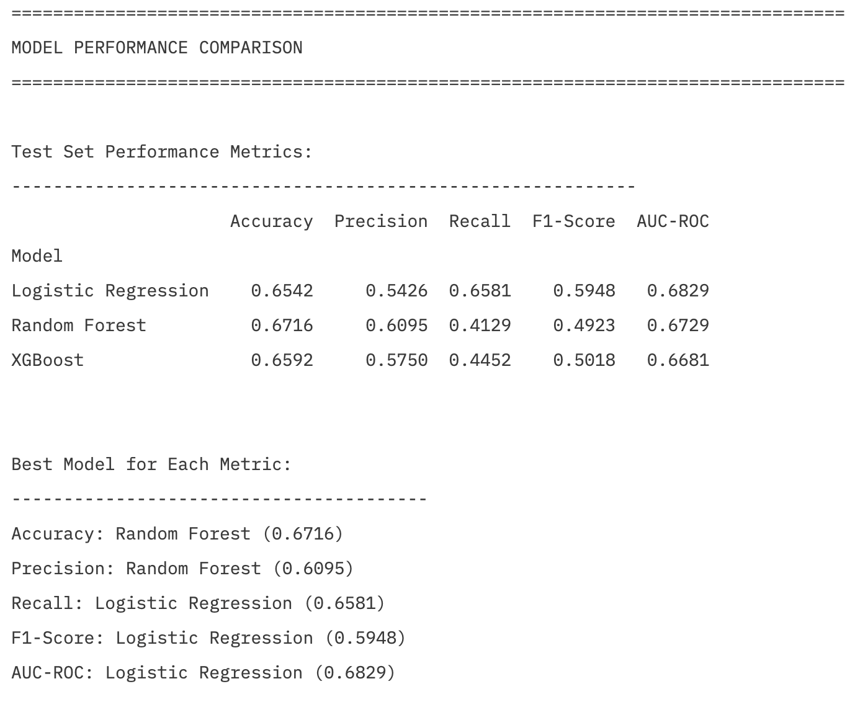

Slide 11
How it solves real world problems?
Helps identify high-risk heart failure patients before discharge.
Supports clinicians in making informed follow-up and monitoring decisions.
Reduces avoidable emergency readmissions.
Improves patient safety and healthcare resource planning.
Provides interpretable predictions that clinicians can trust.

Slide 12
Synthesis of information
Research literature suggests ensemble models often outperform linear models.
However, experimental results show Logistic Regression performed best in this context.
This highlights the importance of matching model complexity to dataset characteristics.
The study demonstrates critical evaluation rather than blind reliance on advanced algorithms.

Slide 13
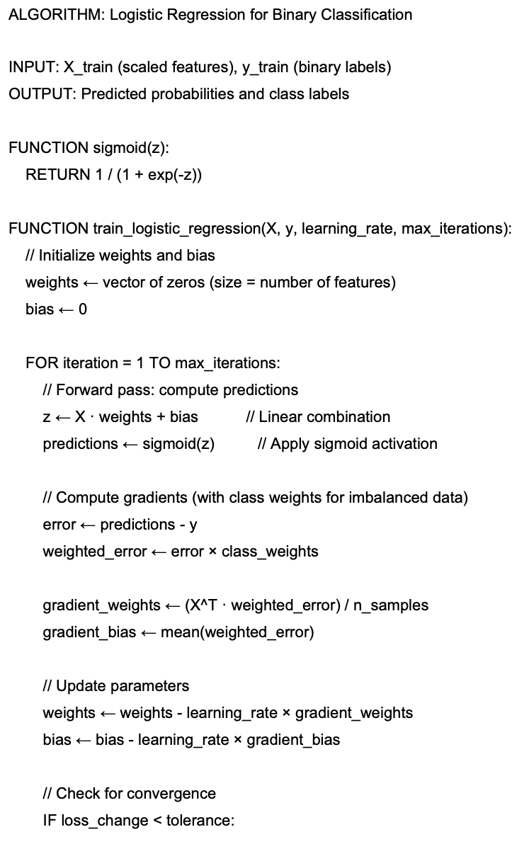
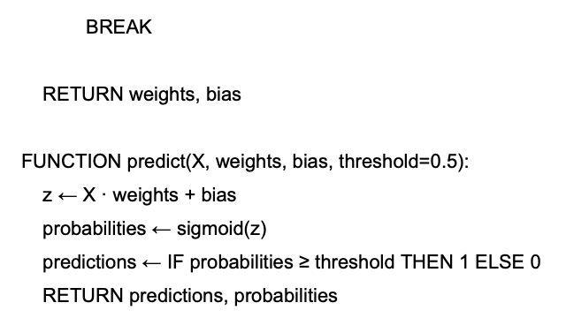
Pseudo code for the solution

Slide 14
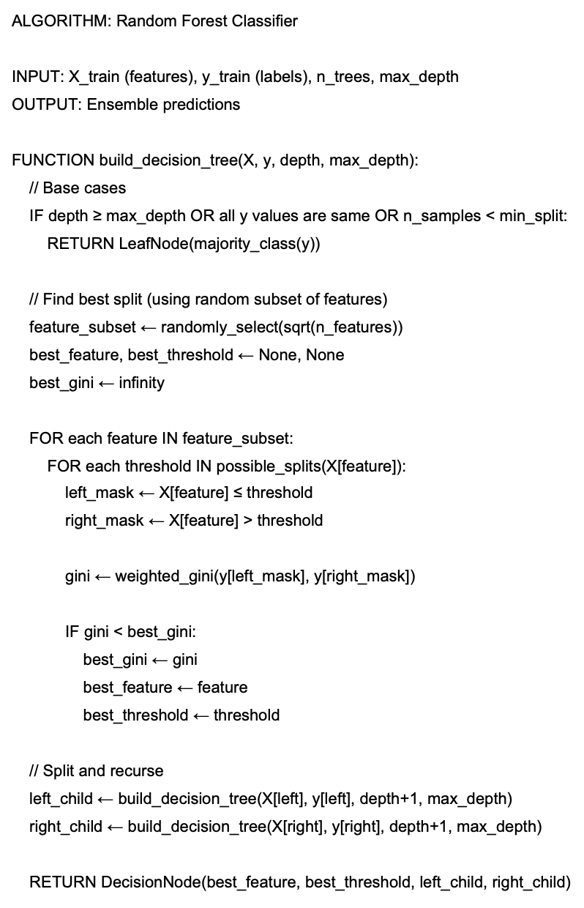
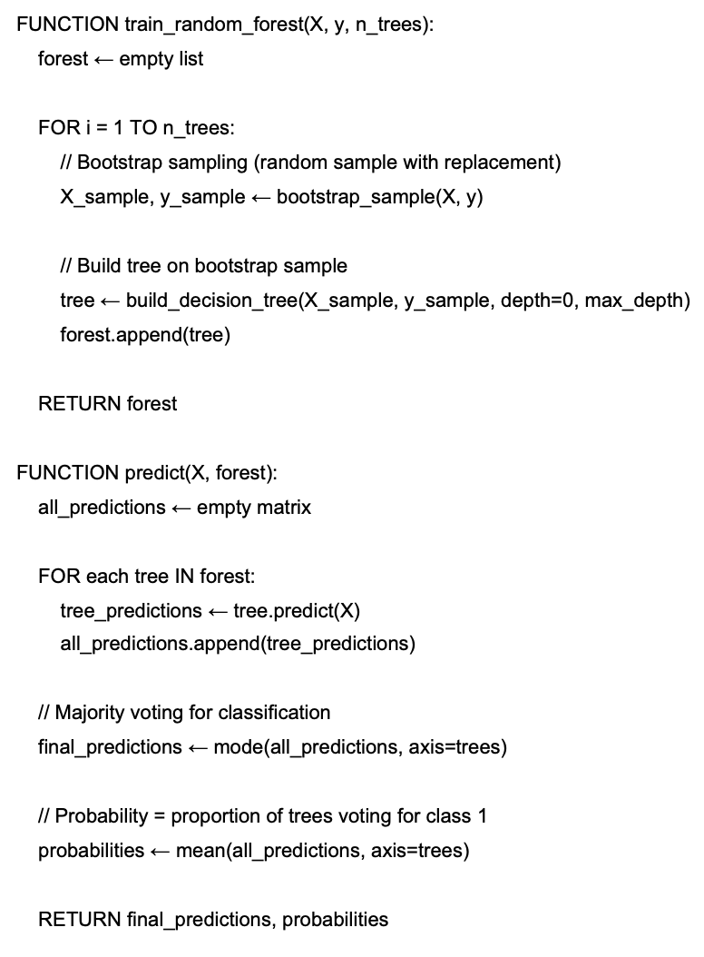

Slide 15
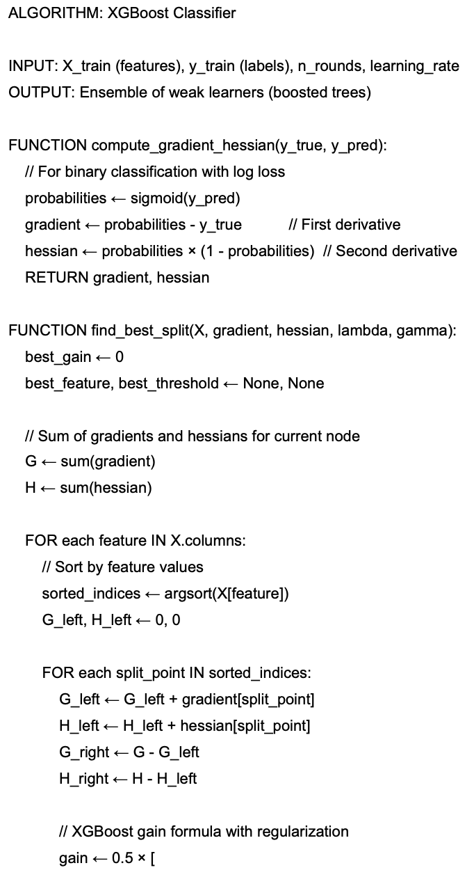
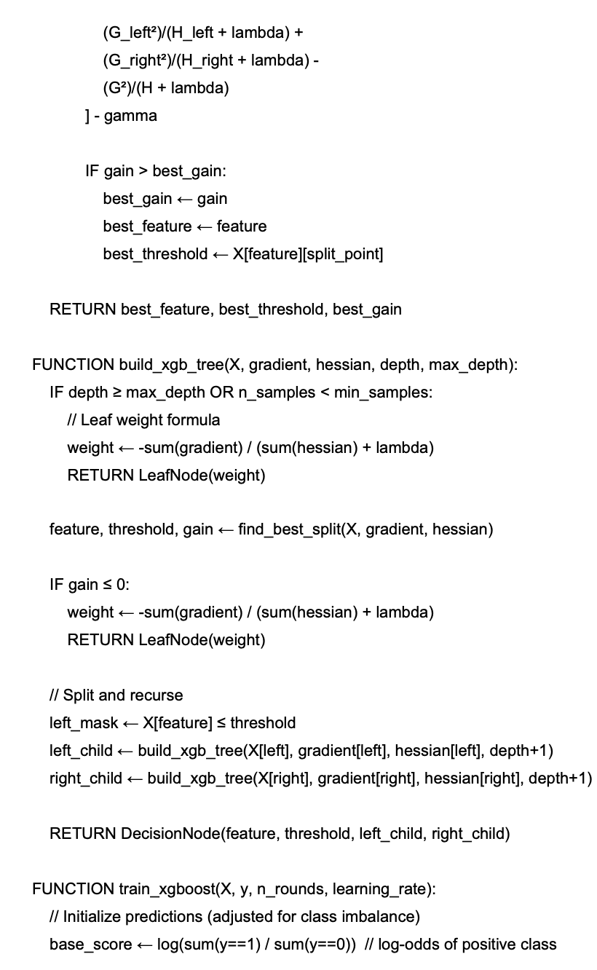
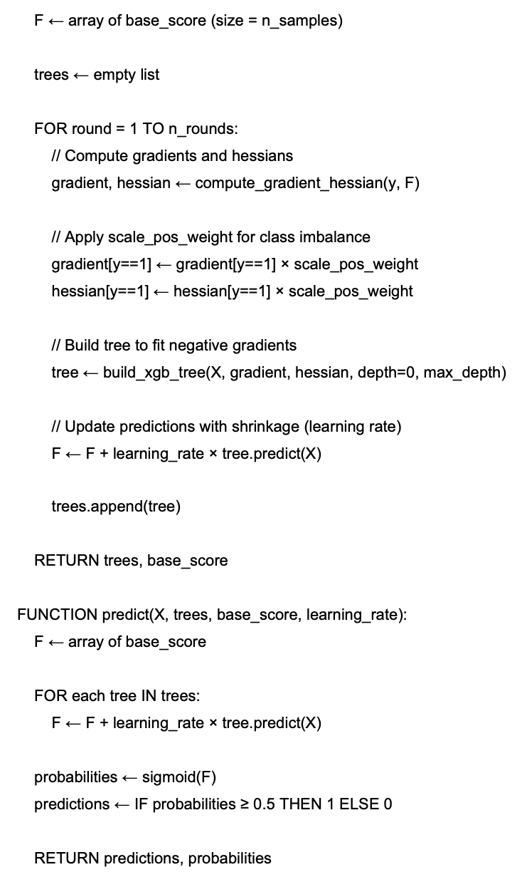

Slide 16
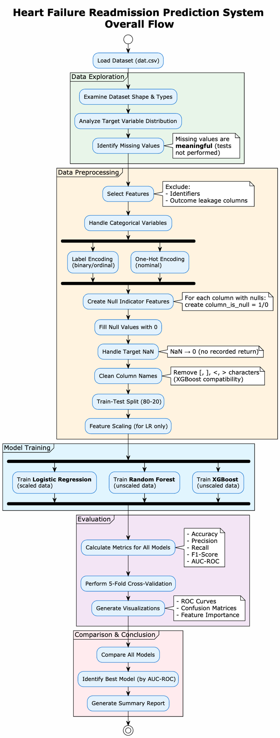
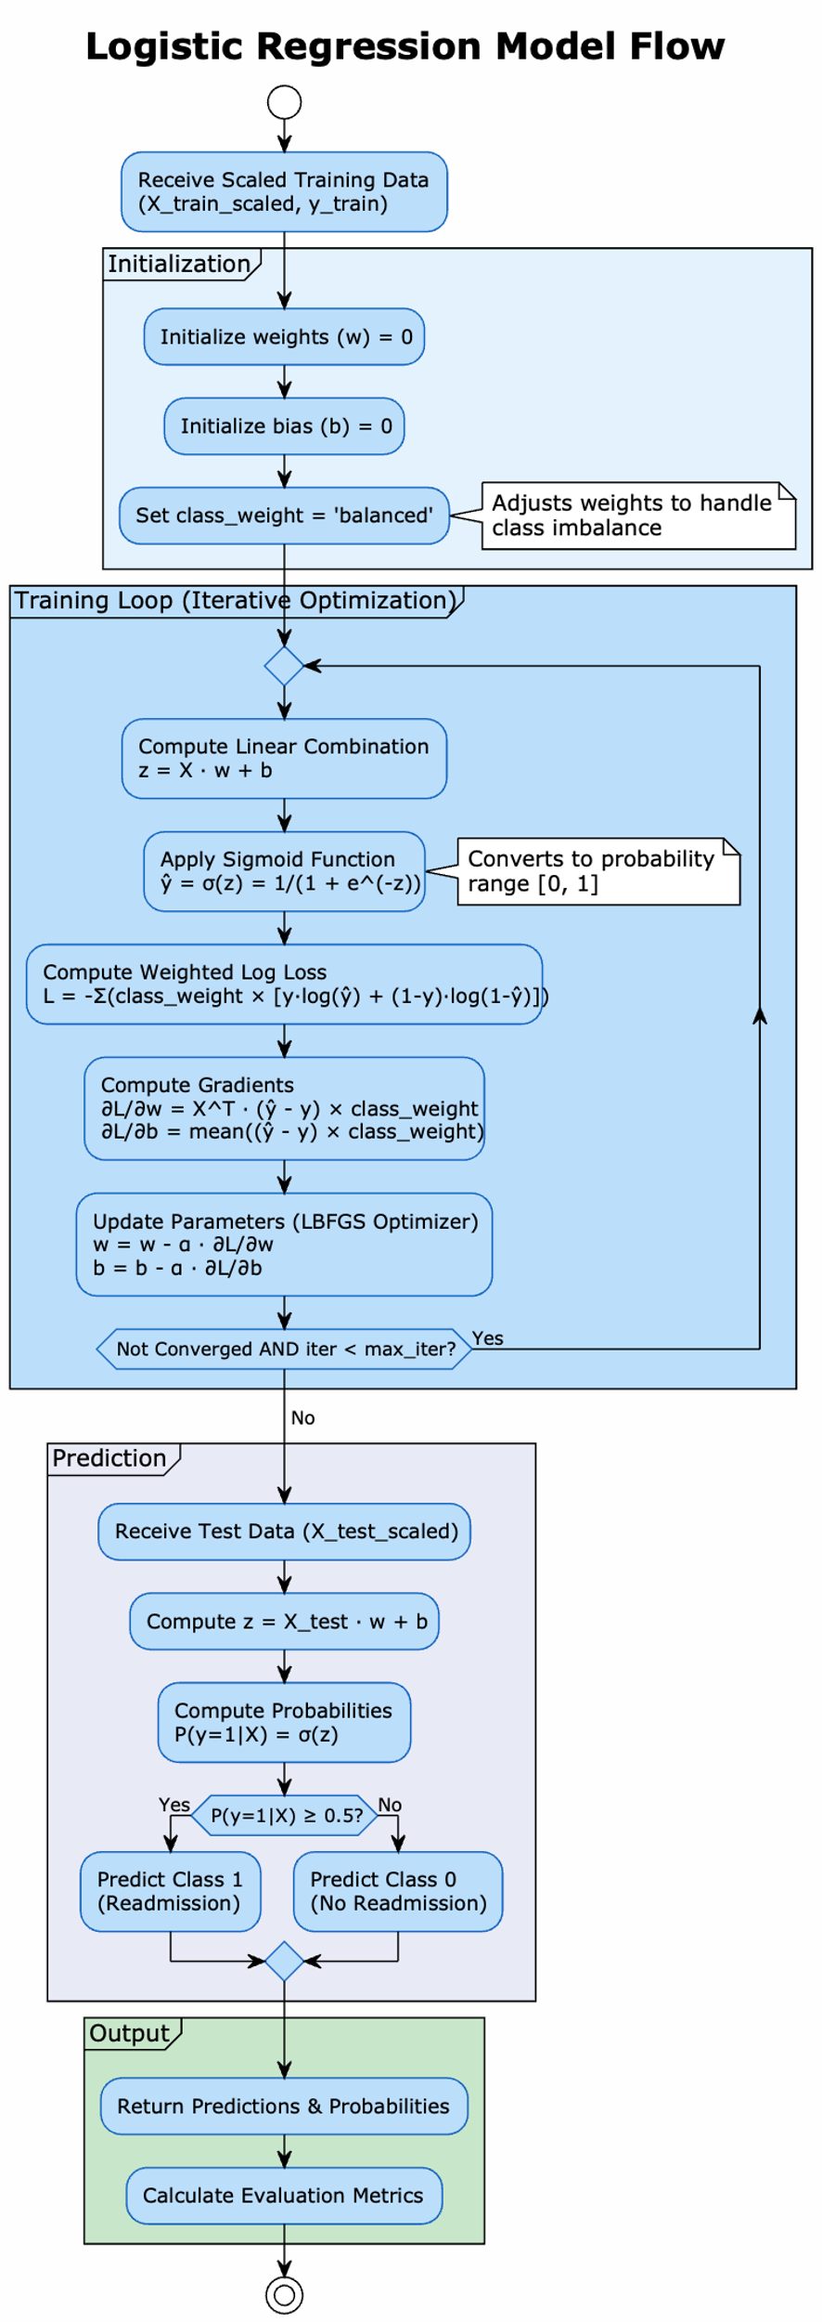
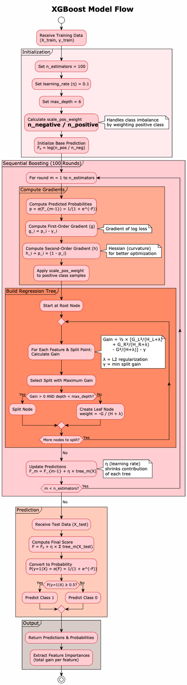
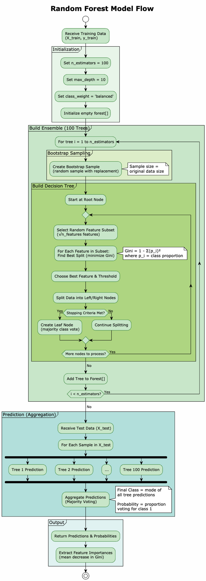

Slide 17
END
23050386
NP01CP4A230194
C8
Prashanna Sthapit

